Slide 1
1
Student Hiring Overview
HSC Human Resources
HSC.HR@untsystem.edu

Slide 2
2
Stages of Student Hiring
Plan 1 month in advance
Post job on PeopleAdmin
(Approx. 1 day)
Submit the hire ePAR
(Approx. 3 days)
Select finalist(s) from candidate pool
(Approx. 2 days)
Confirm completion of Onboarding and the I-9
(Approx. 4 days)
Plan a month in advance of the start date for the entire process to be completed.
Have the following details ready before you begin:
Job Code (1790HR, 1740HR, 1720HR)
Brief department summary
Duties
Hourly rate, # weekly hours (FTE), work schedule

Slide 3
3
Job Codes
1790HR - Student Assistant UNT HSC-Hrly
General HSC student job code. FTE 0.48 or below.
1740HR - Federal Work Study Stdnt-Hrly
FTE 0.48 or below.
1720HR - Graduate Research Assistant
Used if the graduate student is working in a lab and/or assisting a research faculty member with duties on a sponsored research project.
**These job codes are non-exempt**
NOTE: If you want to hire a non-HSC student, they should be hired into a non-student hourly job code.

Slide 4
5
Overview of Hourly Hiring Steps
All steps must be completed before the student begins work.
Post job on PeopleAdmin using the appropriate template.
For Federal Work Study (FWS), a copy of posted job description must be sent to finaid@unthsc.edu
Review all submitted applications against Minimum Qualifications.
Schedule interviews with qualified applicants.
Conduct interviews and, if necessary, verify student is eligible for Federal Work Study.
Submit a hiring proposal for the selected finalist.
Disposition remaining applications appropriately.
After receiving approval from Talent Acquisition, extend verbal offer to the student.

Slide 5
6
Overview of Hourly Hiring Steps
Once the student accepts the offer, notify Talent Acquisition.
For FWS, the student, Financial Aid Office and hiring department must complete the work study verification form.
Once onboarding has been completed, the student can schedule and complete their I-9 verification appointment with HSC HR.
Once the I-9 is verified, HSC HR will send notification to submit a hire ePAR.
Attach the signed offer letter and match the ePAR effective date to the offer letter.
For FWS, also attach the completed Work Study Verification Form.
The hire ePAR cannot be processed until all of the above steps are completed.

Slide 6
4
Hiring a Federal Work-Study Position (FWS)
Email: finaid@unthsc.edu
Phone: (817) 735-2626
Live chat is available for questions or for students to determine their work study eligibility before applying for a job.
The Financial Aid Office does not receive a notification that there is a job posted on PeopleAdmin.

Slide 7

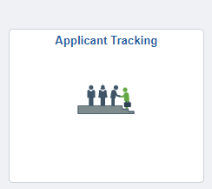

Posting in PeopleAdmin
7
1. Log in at my.untsystem.edu, select Manager Self Service at the top and click on Applicant Tracking tile and click on single sign on to enter your EUID and password.
2. On the right-hand side, click the User Group drop down and select your user group/user role. Initiator, Supervisor, and Department Head are the only users that can create posts.

Slide 8

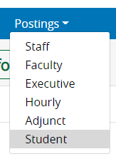
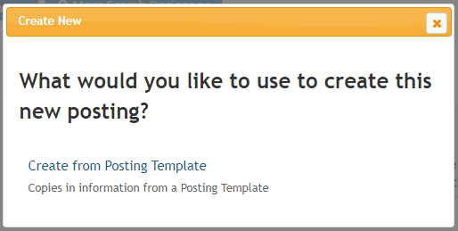
Posting in PeopleAdmin
8
3. Select the POSTINGS drop down menu and select the type of posting needed.
4. Click the orange “Create New Posting” button, then click “Create from Posting Template.”

Slide 9
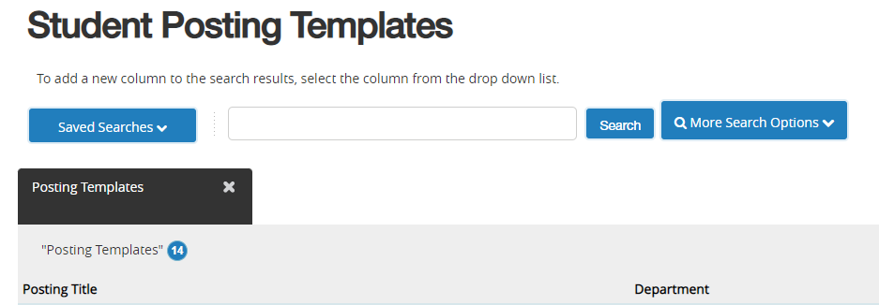
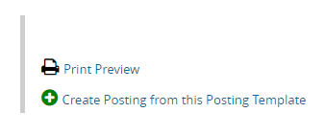
Posting in PeopleAdmin
9
5. Select the template designated for your position from the list.
6. Click “Create Posting from this Posting Template.”

Slide 10
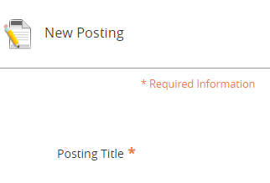

Posting in PeopleAdmin
10
7. Review and edit the title as needed. Add your Division and Department. Click “Create New Posting.”
8. Review and edit all required fields and fill in all relevant information. Click “Save & Continue” at the bottom of each page.
NOTE: Minimum qualifications remain as entered for the job code. Additional requirements can be added to “Preferred” field.

Slide 11

Posting in PeopleAdmin
11
9. Once all sections have been completed, review the information in the summary page.
10. Hover over the Take Action on Posting link and click Approve (Move to Supervisor or next level). Talent Acquisition reviews and posts position live.
All postings must be active in PeopleAdmin for a minimum of five (5) full business days.

Slide 12
Posting in PeopleAdmin
12
Student applications are not reviewed or screened by HSC HR.
The hiring manager is responsible for reviewing the applicants, selecting individuals for interview and conducting interviews.
The hiring manager may request that the position be re-posted and re-advertised if a suitable candidate is not found out of the initial pool of applicants, or if the job requirements change. Contact Talent Acquisition for assistance with this process.

Slide 13
Interviewing
13
Keep eye contact with the candidate.
Give candidates a good understanding of the position.
If using an interview panel, designate who is asking questions and taking notes.
Use open-ended and behavioral-based questions.
Ask the same questions of each candidate.
Keep notes brief. Be mindful of what you are documenting.
Share the next steps in the process.
Smile. Be friendly.
Give the candidate a great experience.

Slide 14
Hiring Proposal
14
Log in to PeopleAdmin.
Make sure your user group is Supervisor or Initiator.
Click on the position name.
Click on the Applicants tab.
Click on final candidate’s last name.
Click on the green + sign ‘Start ATS Hiring Proposal’ in the top right of the page.
Change your user group if you do not see the green + sign and try again.

Slide 15

15
Pre-employment and the Offer Letter
Criminal history checks (CHC or background checks) are required for all new hires and rehires terminated in the system.
If an HSC student was previously employed but is not active as a current employee, a CHC, online onboarding and I-9 verification must be completed again.
Once the CHC has returned with cleared results, they will be registered for online onboarding.
The Recruiting Coordinators will send out a “New Employee Notification” email.
HR Employment will send out “Registered for Onboarding” emails.

Slide 16
16
Pre-employment and the Offer Letter
Verbal offers may be extended once the hiring proposal has been approved by HSC HR.
Discuss the position duties, hourly rate, work schedule, and physical requirements.
HSC HR creates the offer letter and forwards to the hiring manager for signature.
The finalized offer letter is sent to the prospective student hire along with the CHC consent form.

Slide 17
17
Closing the Posting
Contact Talent Acquisition to close the posting to new applications.
Postings can be closed before the position is filled, if the hiring manager determines that there is an adequate pool of applicants and feels confident that a hire can be made from said pool.
Hiring managers must disposition all applicants to their appropriate workflow throughout the hiring process.
All documentation (notes, emails, all interview guides) must be retained per UNTS retention guidelines: Current year + 2.

Slide 18
Onboarding & I-9 Verification
18
Online onboarding, including Section 1 of the I-9, must be completed before the student can schedule their I-9 in-person verification appointment with HSC HR.
Only valid, original documents are accepted for I-9 verification.
It is highly recommended that the student complete online onboarding and the I-9 verification process before their first day of work.
Students are not permitted to work until their I-9 documents have been verified by HSC HR, E-Verify has been completed, and an “Employment Authorized” status is granted.

Slide 19
19
I-9 Process – International Students
International students who do not have a Social Security number (SSN) will need to contact the International Services Office (international@unthsc.edu) upon hire for the information needed on how to apply for a Social Security number before going to the Social Security Administration office.
HSC HR or the hiring manager will provide an Employment Verification Letter as part of the SSN application process. International students may technically begin working before the SSN is issued, however, they will be required to bring their original SSN card into HSC HR within 90 days of their hire date.
HSC HR can re-verify majority of international student’s documents while the International Services Office does reverifications for H-1Bs and J-1s.

Slide 20
Pay Information
20
Student are paid on the 1st and 15th of each month.
The hourly rate should start at $11/hour (not to exceed $20/hour) and reflect:
The position’s relative level of difficulty
Technical skills required
Applicable prior experience
For questions regarding FWS student awards, contact HSC Financial Aid.
Unlike other financial aid, Work Study funds are earned and paid through Payroll.
Payroll Deadlines -- https://finance.untsystem.edu/payroll-deadlines

Slide 21

Weekly Hours
21
Students are limited to 19 hours/week during the Fall and Winter semesters, regardless of how many departments the new hire will be working in.
Students may work up to 40 hours during Summer term (while not taking classes) but will need to reduce their hours when the semester begins.
For specific questions on work hour limitations and exceptions, please contact HSC HR.
If FWS, please also contact finaid@unthsc.edu.

Slide 22

22
Work Week Limitations - FWS
In general, Students are not permitted to work in FWS positions during scheduled class times.
Exceptions are permitted if an individual class is cancelled, if the instructor has excused the student from attending for a particular day, and if the student is receiving credit for employment in an internship, externship, or community work study experience.
Any such exemptions must be documented.

Slide 23
23
Work Week Limitations - International Students
International students working more than 20 hours a week during Fall and Spring semesters can jeopardize their visa status.
F-1 international students are eligible to work more than 20 hours per week during semester breaks and annual summer vacation.
The F-1 visa status is a complex and highly monitored process.

Slide 24
24
Timekeeping
Desk Punch Timesheet (Webclock box checked on hire ePAR)
Student must clock in/out in real time electronically on timesheet.
Missed punches can only be entered by the supervisor or department timekeeper.
Timesheet entry (Webclock box is not checked on hire ePAR)
Student enters the hours worked on timesheet.
All non-exempt employees require timesheet submissions and supervisor approvals by the payroll deadlines to receive a paycheck.

Slide 25
25
Working More Than One Job on Campus
The 19 hour per week limit is cumulative if the student holds more than one job on campus (e.g., if the student works 15 hours per week in one department, they are limited to only working 4 hours per week in another position).
Any student working over the total hour limit for the fiscal year will run the risk of being classified as a benefits- and retirement-eligible employee.

Slide 26
26
Terminations
Part-time hourly student employees are hired At-Will.
For guidance on how to lawfully and appropriately terminate a student employee other than natural attrition such as graduation or end of project, please contact your HR Business Partner.
Termination reasons can include Resignation, Unsatisfactory Performance/Rule Violation, End of Job Assignment, Family Reasons, etc.
When a student worker’s employment ends, the department must submit a termination ePAR in a timely manner, ending the student’s employment.
The ePAR effective date is the next business day after the last day worked.

Slide 27

27
Graduation
Term ePARs will need the reason “end of job assignment” to be used.
All student worker positions end immediately upon the student’s degree being conferred by the Registrar’s Office, unless the student re-enrolls at HSC.
FWS students cannot work past their last class day if graduating that term (Departments are notified of this date by the Financial Aid Office on the monthly payroll earnings report).

Slide 28
Questions?
HSC HR (Onboarding, I-9, ePAR and General assistance)
HSC.HR@untsystem.edu
817-735-2690
550 Bailey Avenue, Suite 330
International Services Office (SSN and hourly employment assistance)
international@unthsc.edu
Student Service Center (SSC), Suite 210
Talent Acquisition (PeopleAdmin assistance)
HREmployment@untsystem.edu
Financial Aid (Federal Work Study eligibility and paperwork)
finaid@unthsc.edu
817-735-2626
Student Service Center (SSC), Suite 150

