Slide 1
Requisition Training
Lana Sacks
Senior Administrative Associate
Pam Peden
Property Manager

Slide 2
What is a Controlled Asset?
A Comptroller’s controlled asset is a capital asset that has a value less than the capitalization threshold established for that asset type, however due to its high-risk nature, is required to be reported to SPA. Controlled assets are not reported in an agency’s annual financial report.
A locally controlled asset is a capital asset that is not capitalized or on the Comptroller’s controlled asset list, but is tracked and accounted for as mandated by agency management
Computers $0.00 - $4999.99
Cameras $500.00 - $4999.99
TVs, Camcorders $500.00 - $4999.99
Data Projectors $500.00 - $4999.99

Slide 3
General Coding Guidelines Controlled Assets
Computers and accessories for that computer get coded the same
TVs and accessories get coded the same
Shipping gets coded the same as the asset
Accessories for already existing controlled assets ordered on a req with a new asset get coded as expensed

Slide 4
Capital Assets
Capital Asset Definitions
Capital assets are real or personal property that have an estimated life of greater than one year. Capital assets may or may not be capitalized for financial reporting purposes.
A capitalized asset is a capital asset that has a value equal to or greater than the capitalization threshold established for that asset type. Capitalized assets are reported in an agency’s annual financial report.

Slide 5
What is a Capital Asset
Equipment or computer at $5,000.00 or greater
Equipment or computer less than $5K but with its accessories equals a total of $5K or greater

Slide 6
General Coding Guidelines Capital Assets
The following are coded the same as the asset:
Accessories or apparatus necessary to make the asset usable and render it into service
Installation and training
Software specifically for the asset
Trade-in
Shipping

Slide 7
What is NOT Considered Part of the Cost of the Asset
Extended warranties or maintenance agreements
Additional parts or consumables not needed to put the asset into service

Slide 8
Equipment that Comes with a Computer
The computer needs to be a separate line item with its cost
Code the computer as a computer

Slide 9
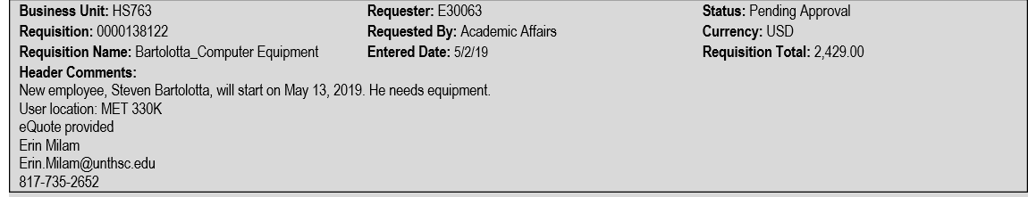
To expedite the process, it is helpful to include this information on the req:
End User, Location, Emplid #, Inventory Deptid

Slide 10
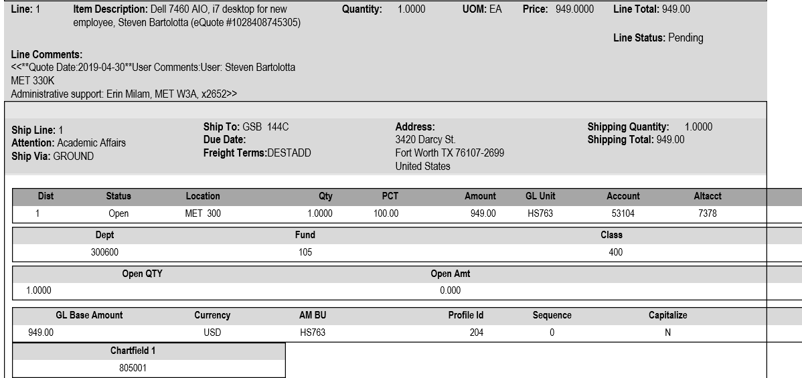
We verify that the description and alt account match.
The category code generates the ps account, the alt account and the default profile.
204-52 generates 53104, 7378, 204

Slide 11
New Asset Notification
This is a courtesy e-mail.
As the Asset Coordinator for your department, note the following asset(s) have been added to your department’s inventory.
Please verify the information provided is correct. If not, please update the Location and Custodian in the EIS Asset Module. See our website for refresher tips on this process: https://www.unthsc.edu/operations/central-services/property-control/
If the asset is going to be taken off campus, please complete a Property Custody Receipt (PCR) and send it to property@unthsc.edu. The form is located on our website:
http://www.hsc.unt.edu/departments/centralservices/CSForms.cfm
There is no need to reply. If you have any questions please contact Property Control at X2152 or email property@unthsc.edu.
****If you are purchasing this asset(s) for a department other than the one listed, respond to this e-mail with the correct department and we will make the changes.
Asset ID | Tag Number | Descr | Serial ID | PO No. | Location | Custodian | Deptid
000001016160 | 301849 | Computer Dell Latitude 7390 | 8RYMNV2 | 0000150292 | EAD 709D | Suzuki,Sumihiro | 303000

