Slide 1
ADDRESSING YOUR MAIL
Susan Crutcher
Mail Services Manager

Slide 2
Letter Envelope #10
Address center or left of center of envelope
Return address in upper left with account number or senders name.
Leave a 5/8 inch to 1inch space along bottom of envelope.
Do not write or have print to the left of the address.
Address should be easy to read, guidelines to right. >
No large paper clips or anything rigid
No staples on Folded Self-Mailers or Double Postcards
Labels and hand printed address can not be at a slant
Do not place anything in the upper right, this is for the postage
For further information contact Mail Services EXT 2219 or susan.crutcher@unthsc.edu

Slide 3
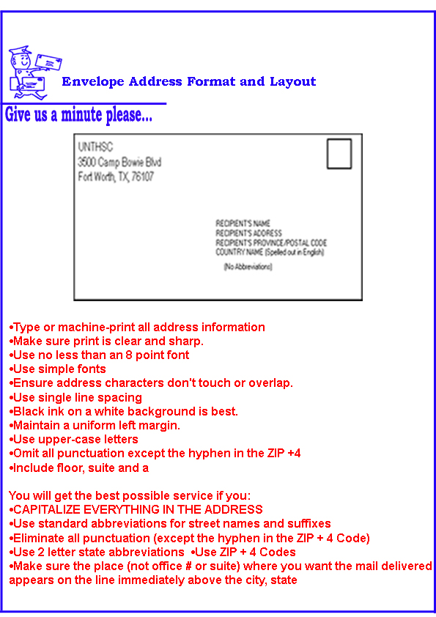
Envelope Address and Layout

Slide 4
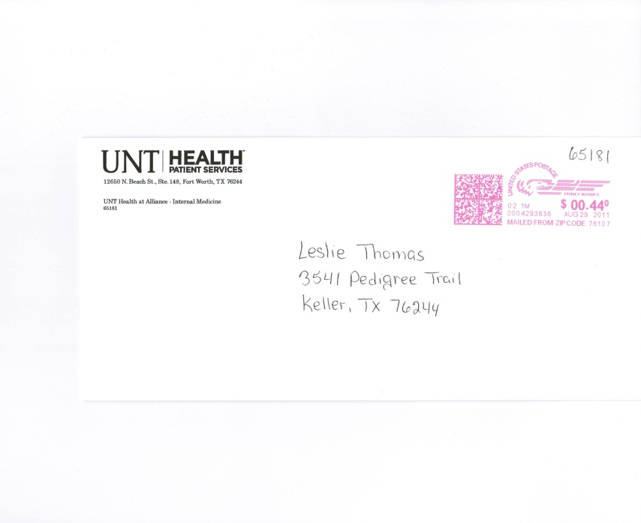
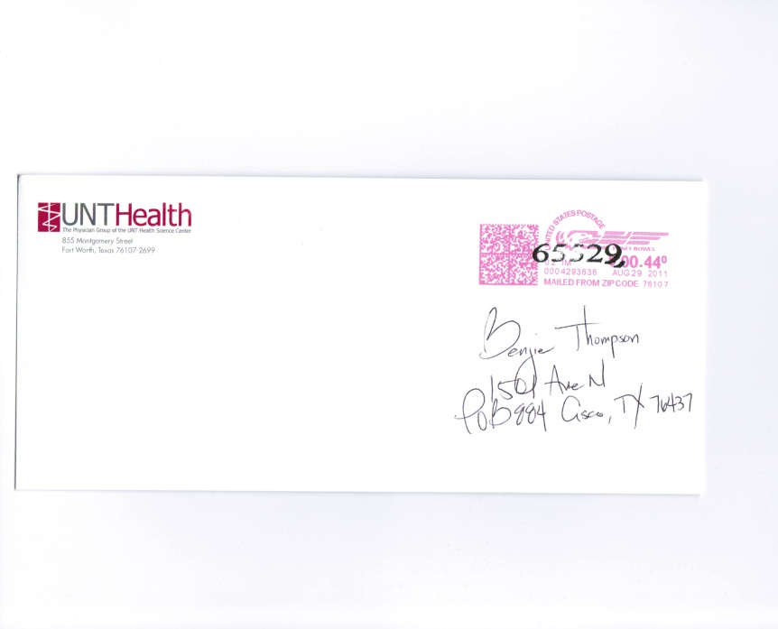
Letter Envelope #10
Correct
Address to center
In print, easy to read
At least 5/8 inch to 1 inch from bottom
Labels should be placed in same area
Wrong
Address to far to right
Print not clear and slants
Account number should be above return address
Do not place anything in the postage area

Slide 5
POSTCARDS & FLATS
Additional Information
Further Guidelines to come

Slide 6


