Slide 1
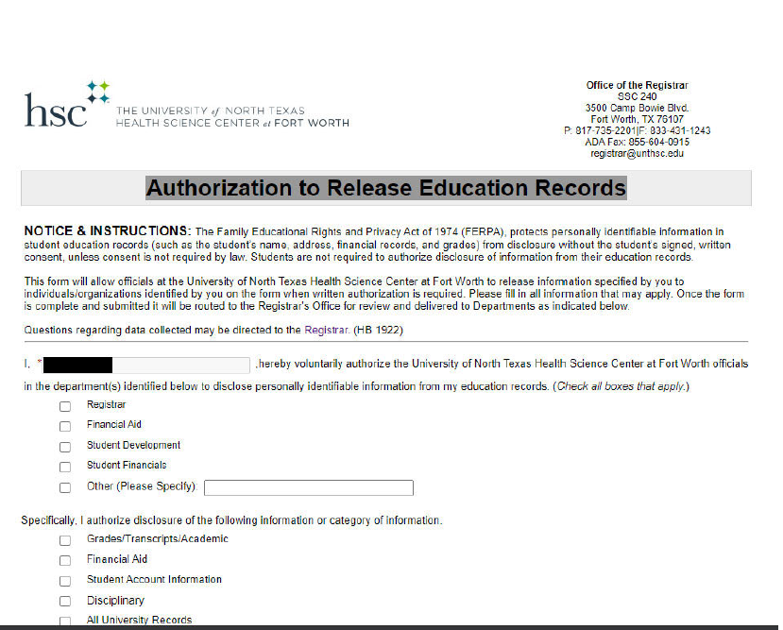

Authorization To Release Education Records
EXAMPLE OF AUTHORIZATION TO RELEASE EDUCATION RECORDS FORM
Notes:
Authorization to release education records is a form you can fill out if you wish for someone else to be able to discuss your records and billing. We will not share any information about your student account unless there is a form for them on file.

Slide 3
Student Finance
Notes:
Hello and welcome to Student finance and the cashier’s office. I will be going through some information about our office, best ways to get in touch with us and the services we provide.

Slide 4

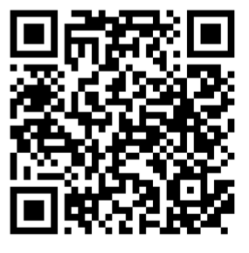
Contact Information
StudentFin@unthsc.edu
SFAccounts@unthsc.edu
Thirdparty@unthsc.edu
1098T@unthsc.edu
Cashier@unthsc.edu
Notes:
The best way to contact us is through live chat on our website and email. You can click on the live chat link on this page and it will take you straight to our website. To contact us by email the first email listed is studentfin box which is where you can ask any questions about your account, especially if you aren’t sure exactly what you need. Then there is SFAccounts, which will be able to answer questions about past due balances and payment plans. Also there is the third party email that will be able to assist you if you have a third party sponsor questions. The cashier email is the best contact to know when you can make an appointment to pay in person, if necessary. Lastly the 1098t email will be the email you correspond with if you are needing to submit a w 9 s form or get information about your 1098t. Also, please go follow our facebook page. Where we post reminders and other helpful information.

Slide 5
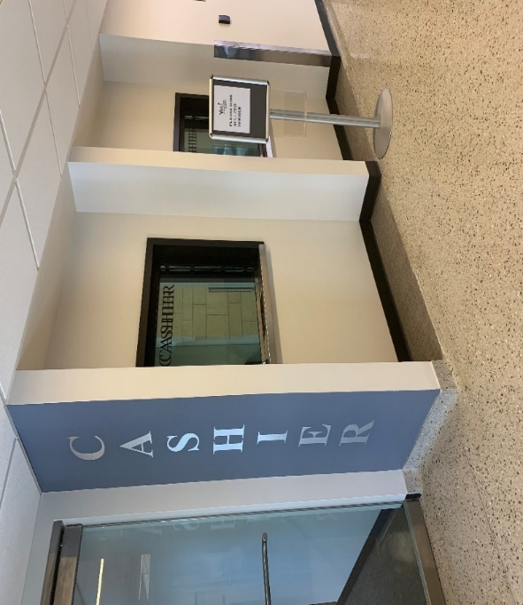
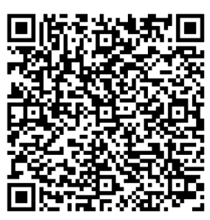
Location & Hours 1051 Haskell St. Fort Worth, Texas 76107
Student Finance Office
Cashier’s Office
M - F 10am – 1pm
M – F 8am – 5pm
SSC Suite 150, 1st Floor
SSC Suite 101, 1st Floor
Schedule Cashier Appointments Here!
Notes:
If you need to stop by our offices to make a payment or drop off any forms we are located in the SSC suite 150 and the cashier office is located suite 101. Payments are made by appointment only and available appointment times are Monday thru Friday between 10am and 1 pm. You can make an appointment online on the cashier services page using this QR code

Slide 6
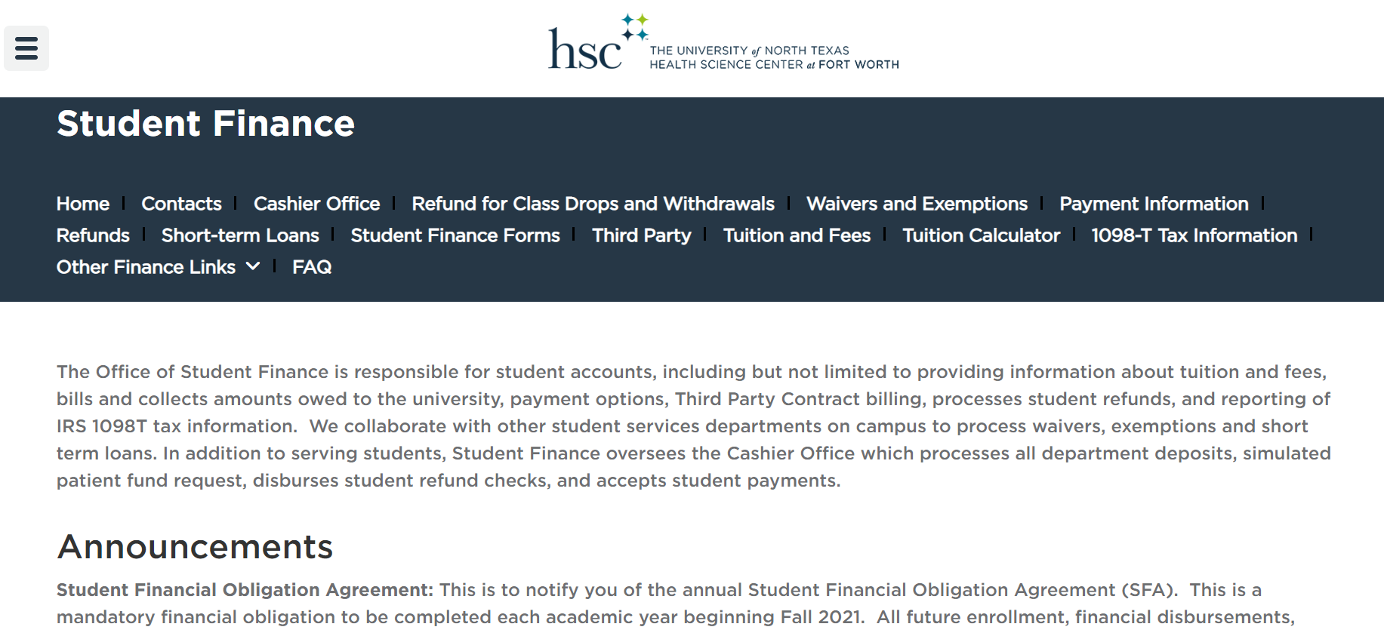
Services We Provide
Student Finance website
Cashier Services
Student Accounts
Payments & Installment Plans
3rd Party Sponsors
Waivers & Exemptions
Refunds
1098T
Notes:
Often times it can be confusing as to what we do versus what financial aid does and the registrar’s office, because we work so closely together. The services we provide are listed below. The cashier’s office processes payments made by check, money order and flywire. We manage students accounts by positing your tuition and fees. We also process online payments and any third party sponsor payments, we offer payment plans, and we apply any approved waivers or exemptions to your account. We process refunds and distribute 1098T’s , detailed information about what we do can also be found on our website.

Slide 7
Payment Information
Payments are due the day prior to the first day of classes
Online Payments thru Student Portal
Pay in person or by mail with check or money order
Drop Box Available in Police Station
Schedule your appointment online for in person payments!
Notes:
Payment Informtion, you can pay online through your student portal by clicking on the myhsc link here, go to student account, and then click on make a payment. This will take you to the quickpay portal where you can enter your information to pay by ececk or credit card. If you choose to pay by echeck you can avoid the credit card service fee. You also have the option to enroll in a payment plan, or pay in person at the cashier’s office by check or money order. Again payments are due the day before classes start and please remember never send cash through the mail.

Slide 8
Check & Money Order Options
Local Banks
EECU
Free checking accounts
Cashier checks $3.00 per check with min. purchase of $1000
Money Order is $2.00 with max purchase of $1000
BB&T Truist
Free Checking & Savings account
$10 for official check
$5 for money order (max. $1,000)
Prepaid Cards
CVS offers prepaid cards ranging from $4.50 - $4.95 per card
Money orders
7-11 offers money orders up to $550 for $1.35
CVS offers money grams for $3.95
Notes:
Check and Money order options, Here you can see information on nearby banks that offer checking accounts, cashier checks, and money orders. If needing a prepaid card or money order you can purchase one at the CVS near campus. Additionally the 7-11 offers money orders as well.

Slide 9
International Payments
International students can use Flywire to make a payment. If you choose this option, please make sure you choose University of North Texas Health Science Center and not the University of North Texas Denton campus.
Go to pay.flywire.com
Find your educational institution (University of North Texas Health Science Center), select your country, and choose a payment method. Fill in your details, make your payment, and receive your confirmation.
If you have any questions, you may contact Flywire at:
Phone: 1-800-346-9252
Email: support@flywire.com
flywire.com/help
Notes:
International Payments are accepted through flywire, go to pay.flywire.com, find your education institution (University North Texas Health Science Center), select your country, and choose a payment method. Fill in your details, make your payment and receive your confirmation. Please note when you receive confirmation that payment is processed it may take 7-10 business days to reflect in your student portal. If you have questions you can contact flyer at: 1-800-346-9252, email support@flywire .com and visit their website at flywire.com/help. Western Union will become another option for international payments soon.

Slide 10
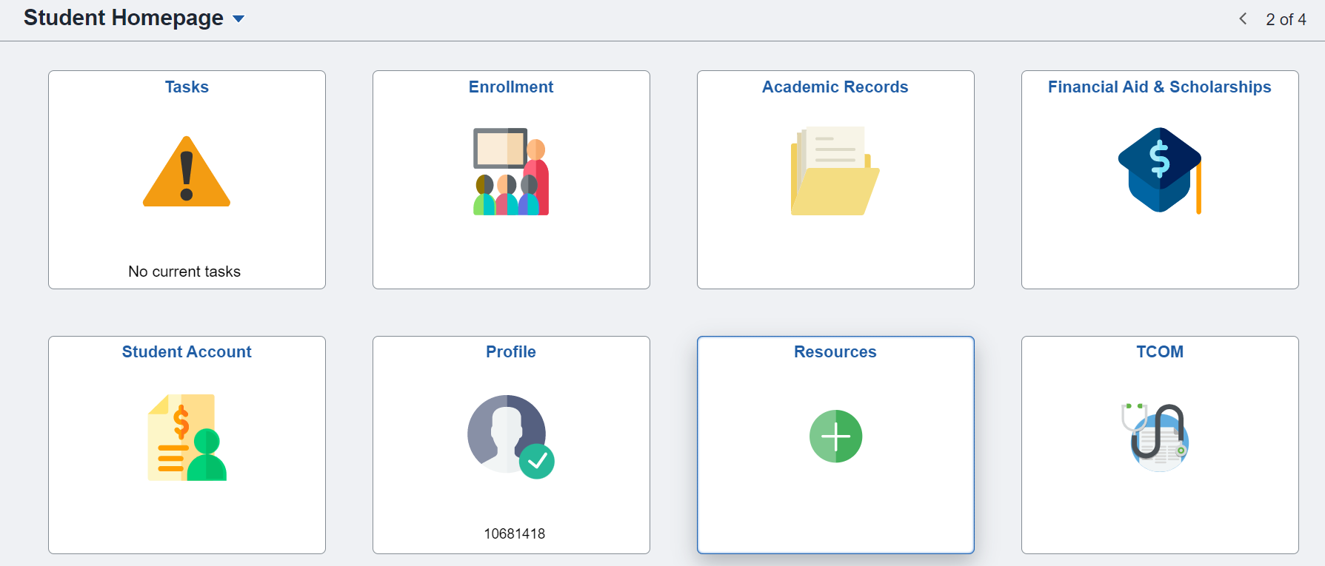
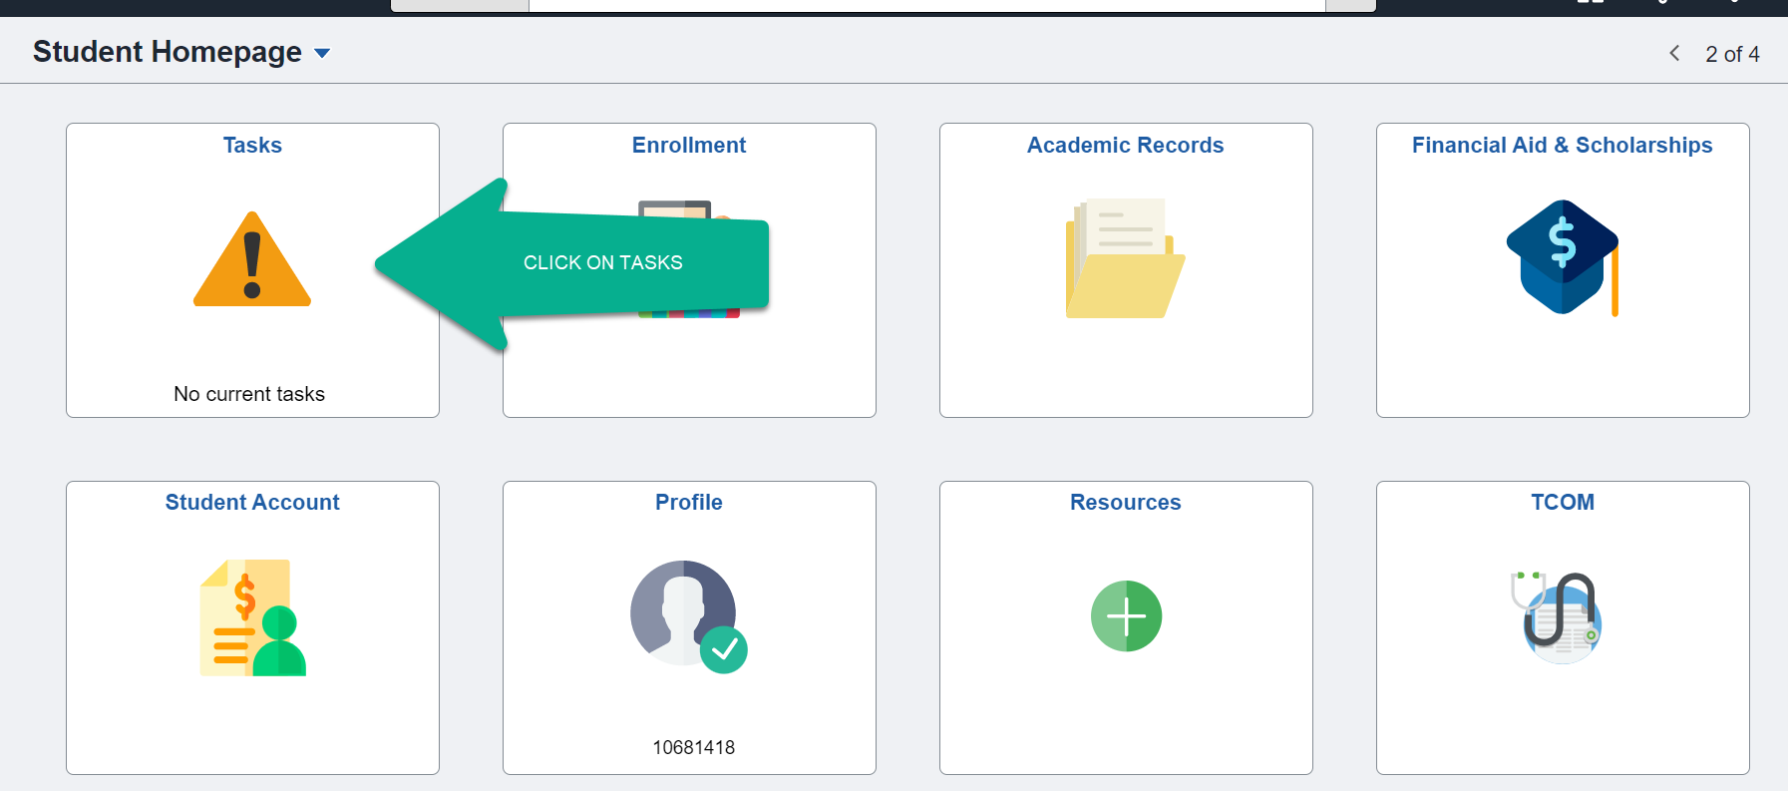
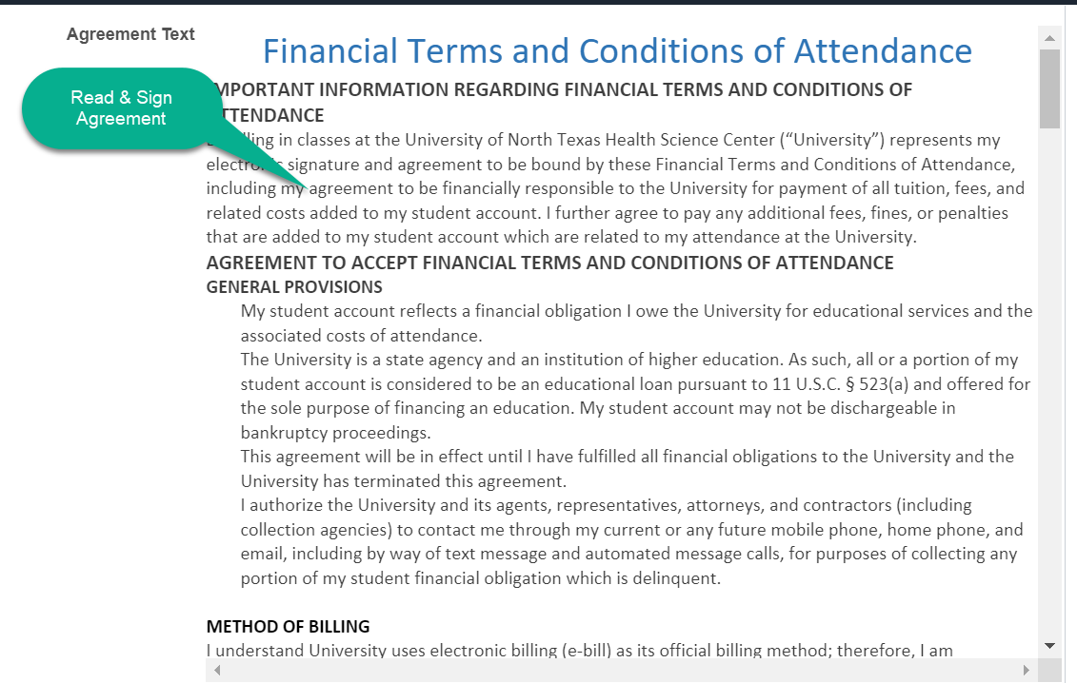
Student Financial Obligation Agreement
Notes:
Every student is required to sign a student financial agreement each year and you can do so in your student portal click on tasks, then under to do list click on Student Financial Agreement.

Slide 11
Student Financial Obligation Agreement
Notes:
Every student is required to sign a student financial agreement each year and you can do so in your student portal click on tasks, then under to do list click on Student Financial Agreement.

Slide 12
Student Financial Agreement
Notes:
Every student is required to sign a student financial agreement each year and you can do so in your student portal click on tasks, then under to do list click on Student Financial Agreement.

Slide 13
Student Financial Agreement
Notes:
Every student is required to sign a student financial agreement each year and you can do so in your student portal click on tasks, then under to do list click on Student Financial Agreement.

Slide 14
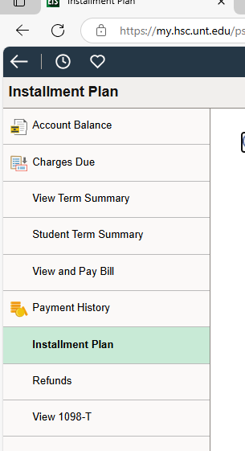
Installment Plans
Notes:
If a students have a balance due in the current term, please have them go to the “Installment Plan” tab in their MyHSC self-service and then click on the pay bill button it shows when they get there

Slide 15
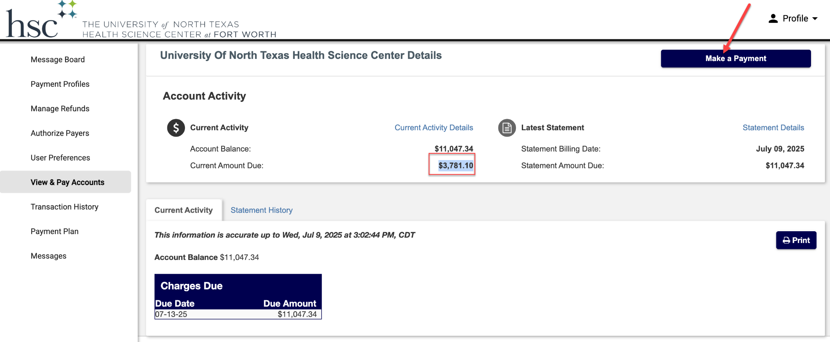
Installment Plans
Notes:
It will then take them to the “View & Pay Accounts” tab in QuickPay where it will show them the “Current Amount Due: ” (which is their down payment) as shown below. They will need to hit the “Make a Payment" button.

Slide 16
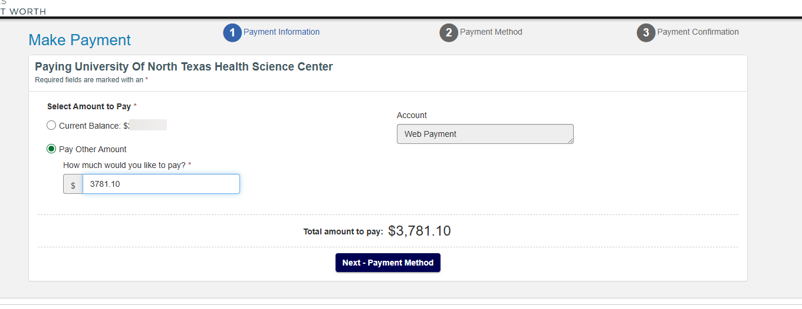
Installment Plans
Notes:
Then select the “Pay other amount" option where they will need to enter the EXACT “Current Amount Due” shown on the last page. Once they finish making that payment they should be enrolled in the installment plan.

Slide 17

Third Party Payments
Vendor/Sponsor must sign a contract (promise of payment).
Third Party Contract can be found on our website Student Finance Forms page.
Student contract for Texas Tomorrow only.
Contracts must be submitted 10 days prior to the first day of class.
For any question related to Third Party Contract/Billing benefits please email: ThirdParty@unthsc.edu or call 817-735-0676
Notes:
Third party payments are payments made for your tuition and fees by a vendor or sponsor. If you have a sponsor that will be paying your tuition they must sign a contract and this must be submitted 10 days prior to the first day of class. To find the contract please click on the hyperlink on this page or see our website Student Finance forms page. For any questions For any question related to Third Party Contract/Billing benefits please email: ThirdParty@unthsc.edu or call 817-735-0676

Slide 18

Refunds
After your Financial Aid is disbursed, Student Finance will process refunds approximately 10 days prior to start of classes.
Refunds are normally processed on Tuesdays and Thursdays.
You may receive your refund via:
You may sign up for Direct Deposit on your MyHSC Student Portal > Student Account > Refunds
Direct Deposit
Reloadable Debit Card
Notes:
Ok now for the information you really want to know! Refunds! You can expect to see your financial aid disburse approximately 10 days prior to the first day of class. Refunds are normally processed on Tuesdays and Thursdays. You may receive your refund by direct deposit or reloadable debit card. All students are required to make their student Choice refund option in the MyHSC > student account > direct deposit.

Slide 19

1098-T
When
Disbursement Date January 31st
Where
MyHSC Student Portal > Student Account > 1098T
Why
The 1098-T Tax Form provides information to the student about tuition and fees paid to HSC. This information can be used by the student to potentially receive a credit on the student’s tax return or, if the student is a dependent, on the parent’s tax return. W-9 emails are sent to those missing SSN/ITIN. For more information email 1098T@unthsc.edu
Notes:
1098 t’s are disbursed on January 31st. When logged into your student account you can view and download your 1098t by clicking on the last tab labeled view 1098t.

Slide 20



Make Sure Your Contact Information Is Up To Date
It is vital that your information with the school stays up to date.
Mailing Address Email Address Phone Number
Current Students – Update information on your Student Home Page > Profile
All official school communication is sent to your unthsc.edu email. It is your responsibility to check this. Remember you can forward unthsc.edu email to your personal email.
Notes:
Please be sure that your contact information is up to date. We will primarily communicate with you through your student email but it is very important that your mailing address and phone numbers are correct.

Slide 21



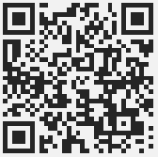
Contact Us
Monday – Friday 8am to 5pm
817-735-2026
Waitwhile
Notes:
Lastly, here is our main contact information again. Our business hours are from 8-5 Monday thru Friday The best ways to contact us are through email and live chat. If you choose to leave a phone message we will get back to you at our earliest convenience. Thank you for your time and if you have any questions please don’t hesitate to reach out to us.

